Slide 1
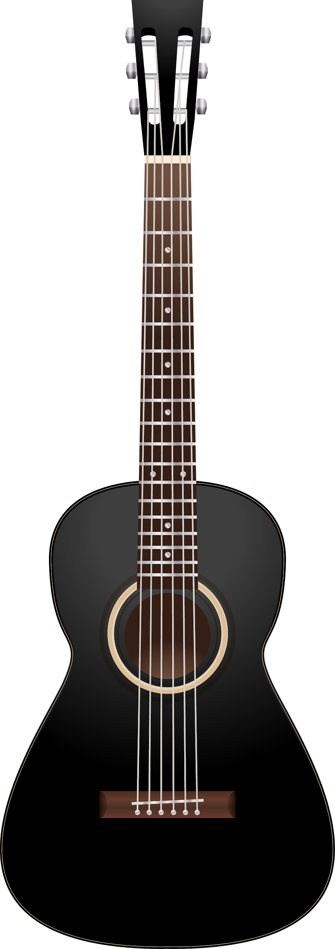
EECE4632
FPGA Guitar Pedal
David Noble and Clara Small
Notes:
David

Slide 2
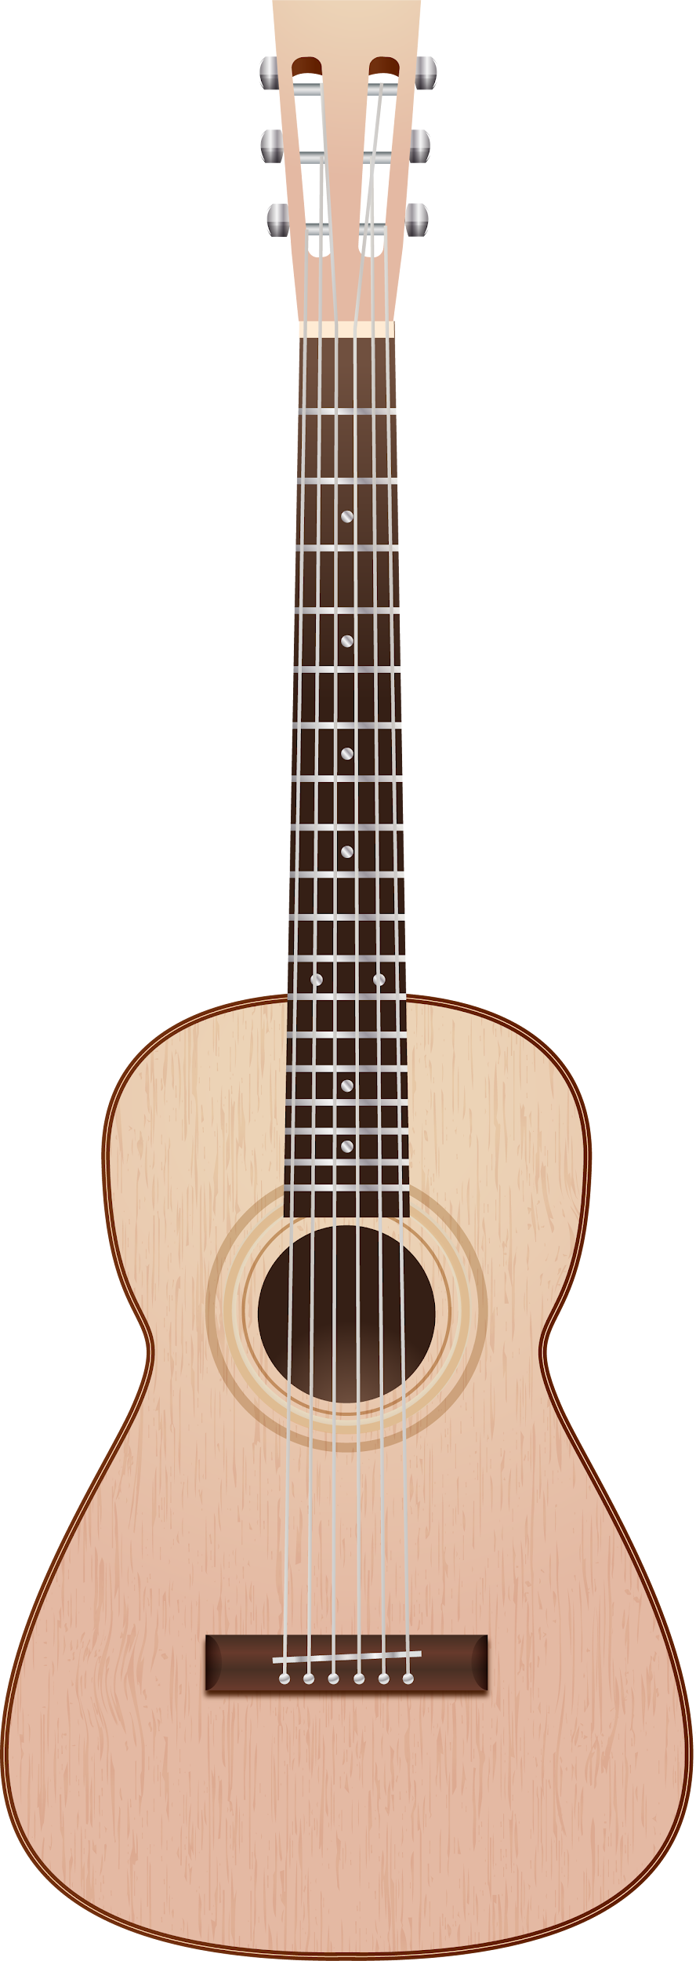
INTRODUCTION
We implemented the guitar pedal effects echo, chorus, tremolo, and soft and hard clipping distortion on the AUP-ZU3 board.
Inputs: .wav file, switches
Output: .wav file (Python)
Notes:
David

Slide 3
The effects
01
Soft/Hard clipping
02
Echo
03
Tremolo
04
Tremolo
Applies a gain, and crops signal at a threshold
Soft uses ‘tanh’ to smooth values close to threshold
Adds a delay using a circular buffer, offset by a set number of samples x a small gain
Makes a single instrument sound like many
Adds delay and pitch modulation copy of itself
Delay modified by a LFO and linear interpolation to prevent quantization.
Multiplies the audio by a low-frequency oscillator (LFO) which modulates the volume of the signal.
Notes:
David
1 - Applies a gain to boost the signal, then cuts at a threshold. Soft uses a `tanh` function to smoothly cut values as they approach the threshold.
2 - Adds a delay using a circular buffer offset by a set number of samples and combining this with a small gain value.
3 - Multiplies the audio by a low-frequency oscillator (LFO) which modulates the volume of the signal.
4 - Adds slightly delayed and pitch-modulated copy of itself to make a single instrument sound like many. Used delay modified by a LFO and Linear interpolation to prevent quantization.

Slide 4
Software Testing Results
Hard Clip: 0.75417 s
Soft Clip: 0.61680 s
Echo: 0.36252 s
Trémolo: 0.60201 s
Chorus: 1.47538 s
Notes:
wayyy too much time delay if you’re playing in real time David

Slide 5
Vitis implementations
Do while loop to run effects on the audio sample
Input switches get processed as bools
Hard/soft clipping and tremolo simple functions
Echo and chorus are looped in the topfile
They required buffers to store previous sample information to use in the calculations
Notes:
Clar
started with a simple code to test the audio, built the c++ program inside of that. the main thing is a do while loop for each sample in the input audio sample.
we used the switches on the boards as inputs, checking if each of them is on and they each correspond to an effect. so it’s possible to stack effects
hard clipping, soft clipping, and tremolo are done in pedal_c.cpp which are simple functions that return the altered audio sample. these functions were very similar to the python implementation, obviously with different syntax
the echo and chorus effects had to be done in the topfile because they require information from previous samples with buffers. so they are stored in the top program, and the sample_count increments every time, until it gets to the sample rate and it resets to 0.

Slide 6
Hardware Exploration
Iteration | Changes |  | Size (LUTS)
1 | Initial Design: Using cmath and Floating point |  | 110,819
2 | Using hls_math and fixed<32,16> |  | 68,974
3 | Less division in Soft Clipping |  | 48,694
4 | FIXED_T fix for tremolo quantization (untested) |  | 65,166
Notes:
Clar
all of the speeds were about the same, so we focused on size

Slide 7
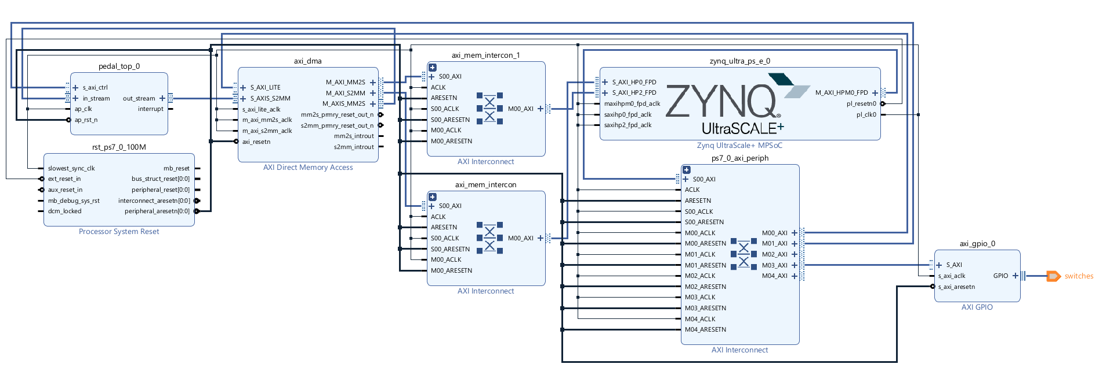
Vivado implementation
MERCURIO
Switches
Audio Codec
Most time working on this was spent on getting an audio codec to work and not succeeding.
Added an axi_gpio block to external pin. Pinout get defined in the constraints
Notes:
David

Slide 8

Results - listening
All - Tremolo
Original Audio
Hard Clipping
Soft Clipping
Echo
Tremolo
Chorus
Notes:
clar

Slide 9

Results - speed up
Hard clipping 0.0383 s - 19.6 x Faster
Soft clipping 0.0386 s - 16 x Faster
Echo 0.0381 s - 9.5 x Faster
Chorus 0.0392 s - 37.6 x Faster
Tremolo 0.0381 s - 15.8 x Faster
Hard + echo 0.0379 s - 10.2 x Faster
Soft + chorus 0.0379 s - 38 x Faster
Echo + chorus 0.0379 s - 39.3 x Faster
All of them 0.0380 s - 100 x Faster
All - tremolo 0.0383 s - 83.7 x Faster
Notes:
clar

Slide 10
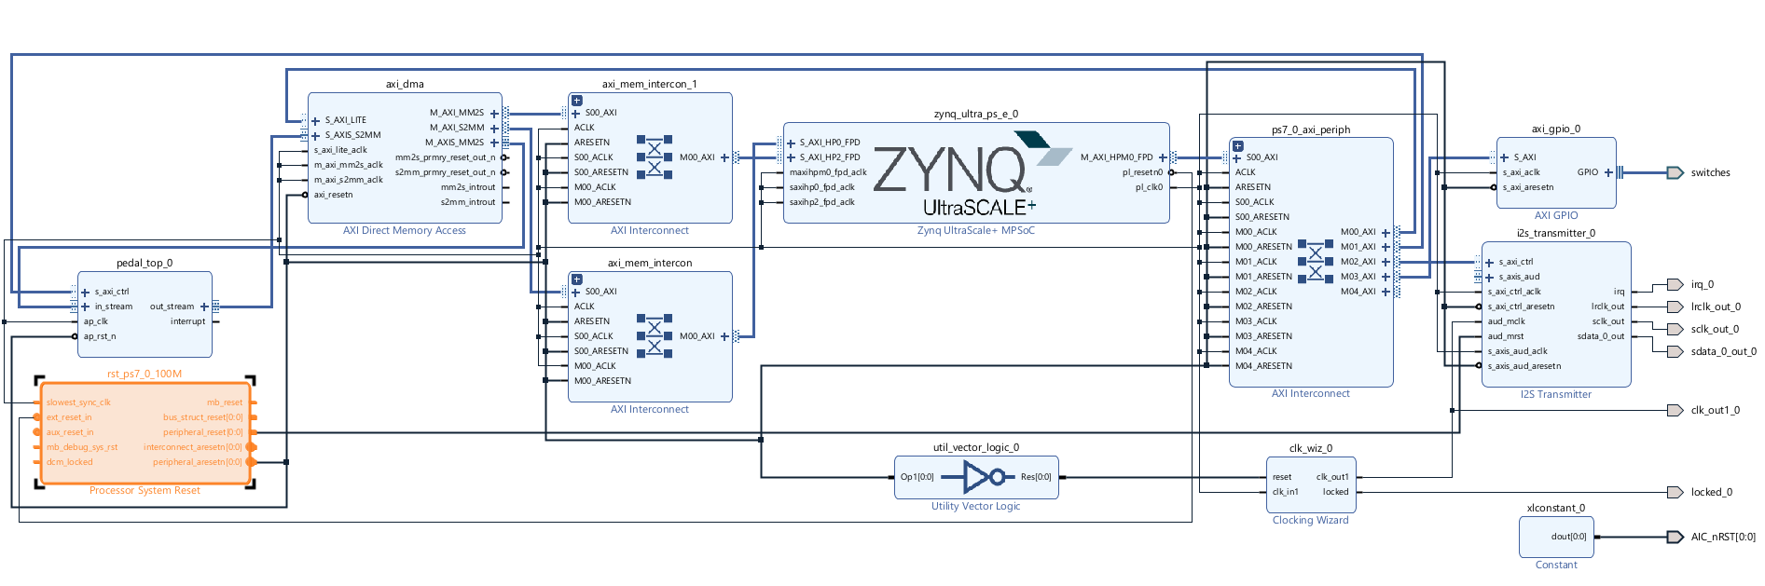
Moving forward
Future goals
Lessons learned
Fix Audio Codec
Fix Tremolo Quantization
How to access different parts of the board (switches, buttons, etc)
How to code for hardware (fixed point vs floating, HLS specific libraries)
Notes:
David

Slide 11

Thank you!

